Slide 1
LCD Custom Characters
Christopher Sever
David Grosby

Slide 2
Outline
LCD Overview
LCD Interface
Initialization Explanation
Custom Character Creation
Set command register to CGRAM
Write to CGRAM
Write to LCD screen from CGRAM address

Slide 3
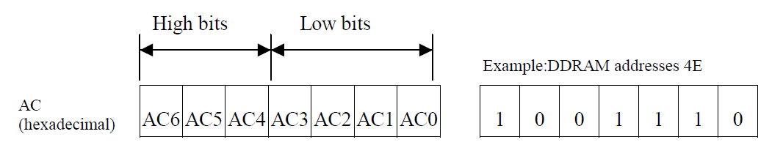
LCD Overview
16x2 Character Display
Two 8 bit registers
Instruction register (IR)
Data register (DR)
Address Counter (AC) – assigns addresses to DDRAM and CGRAM
Busy Flag (BF) – Equals 1 when a command is being processed
Displays 5x8 or 5x10 dot characters
5x8 – 8 custom characters can be created
5x10 – 4 custom characters can be created

Slide 4
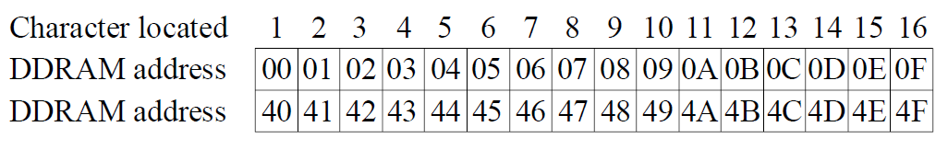
LCD Registers
IR used by Microprocessor to control:
Instruction codes
Address information
DR temporarily stores data to be read/written from/to
DDRAM (Display Data RAM)– stores what will be displayed to the LCD
CGRAM (Character Generator RAM)– stores byte information taken from the CGROM

Slide 5
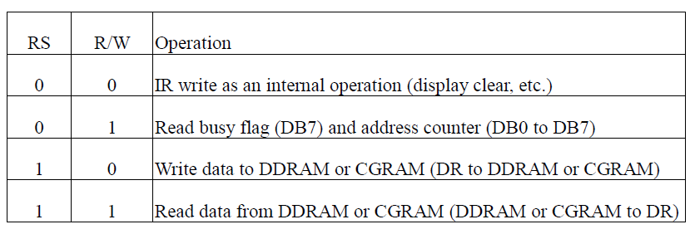
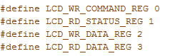
Read/Write Bits
RS and R/W bits are used to control the data flow

Slide 6
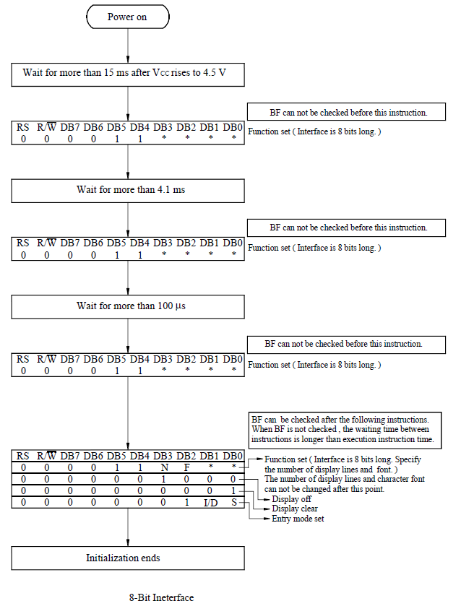

Slide 7
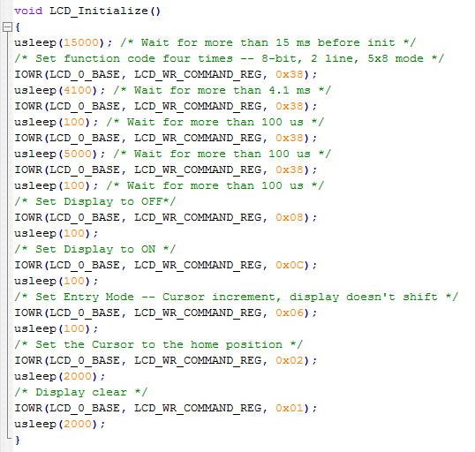
LCD Initialization

Slide 8
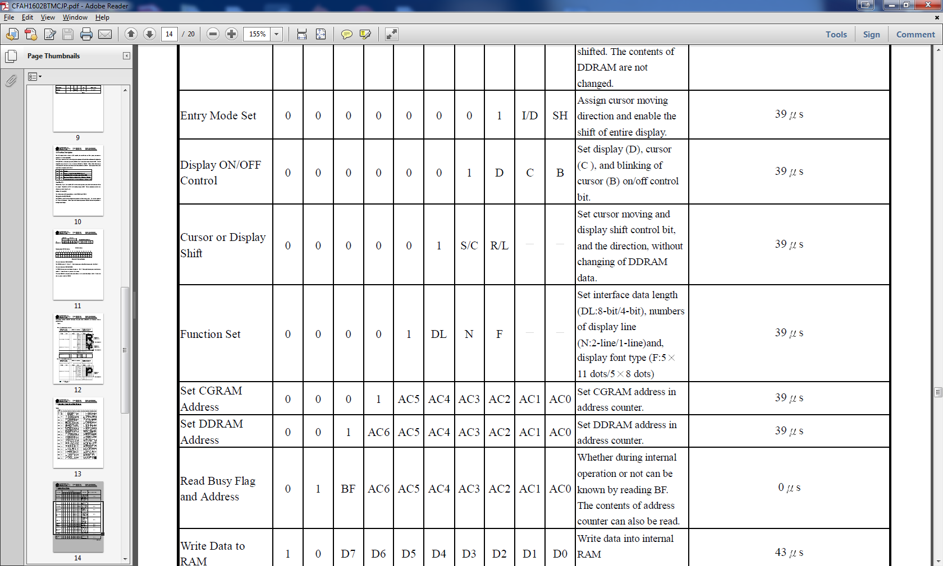
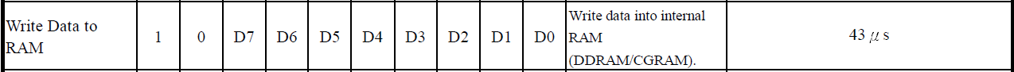
Commands Summary

Slide 9
How to Program Custom Character on LCD
Main steps:
Set command register to CGRAM
Write to CGRAM
Write to LCD screen from CGRAM address

Slide 10

Set command register to CGRAM
Once command register is set to CGRAM, all data written to LCD_WR_DATA_REG will create a new custom ROM

Slide 11
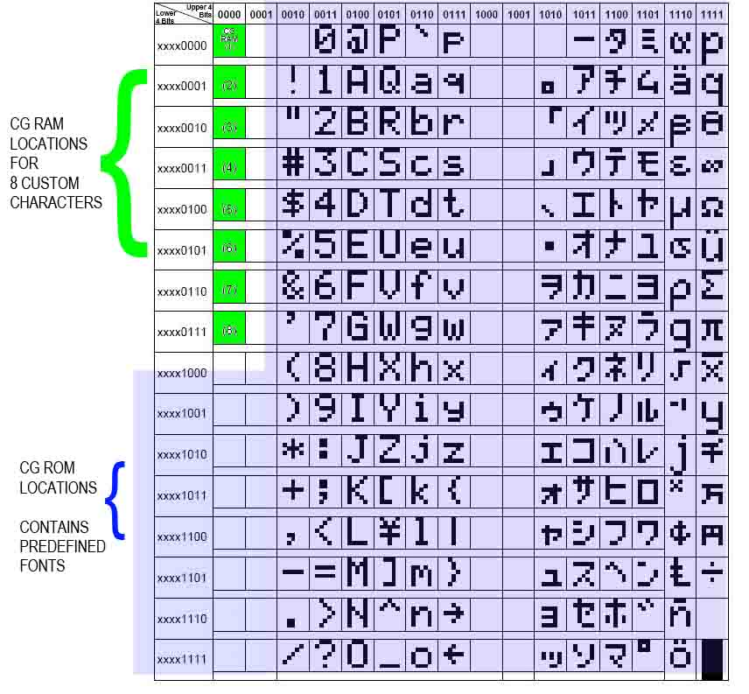
Writing Custom ROMs

Slide 12
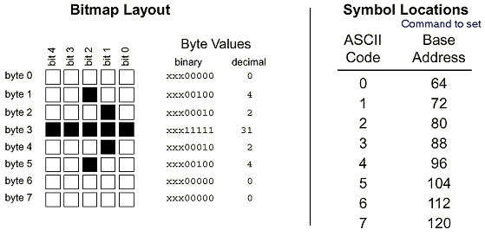
Writing Custom ROMs
1 custom ROM is composed of 8 bytes
Write all 8 bytes to draw custom character

Slide 13
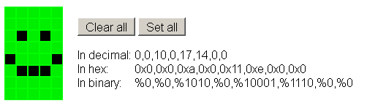
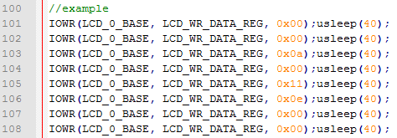
Example Character

Slide 14
Writing Custom ROMs
After all desired ROMs are written into memory the command register must be set back to 0x80

Slide 15
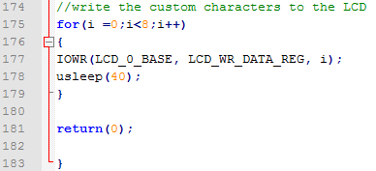
Displaying ROM on LCD
After command register is set to 0x80, any data written to the register will be displayed on the LCD panel
This simple for loop outputs all 8 custom characters to the LCD panel

Slide 16
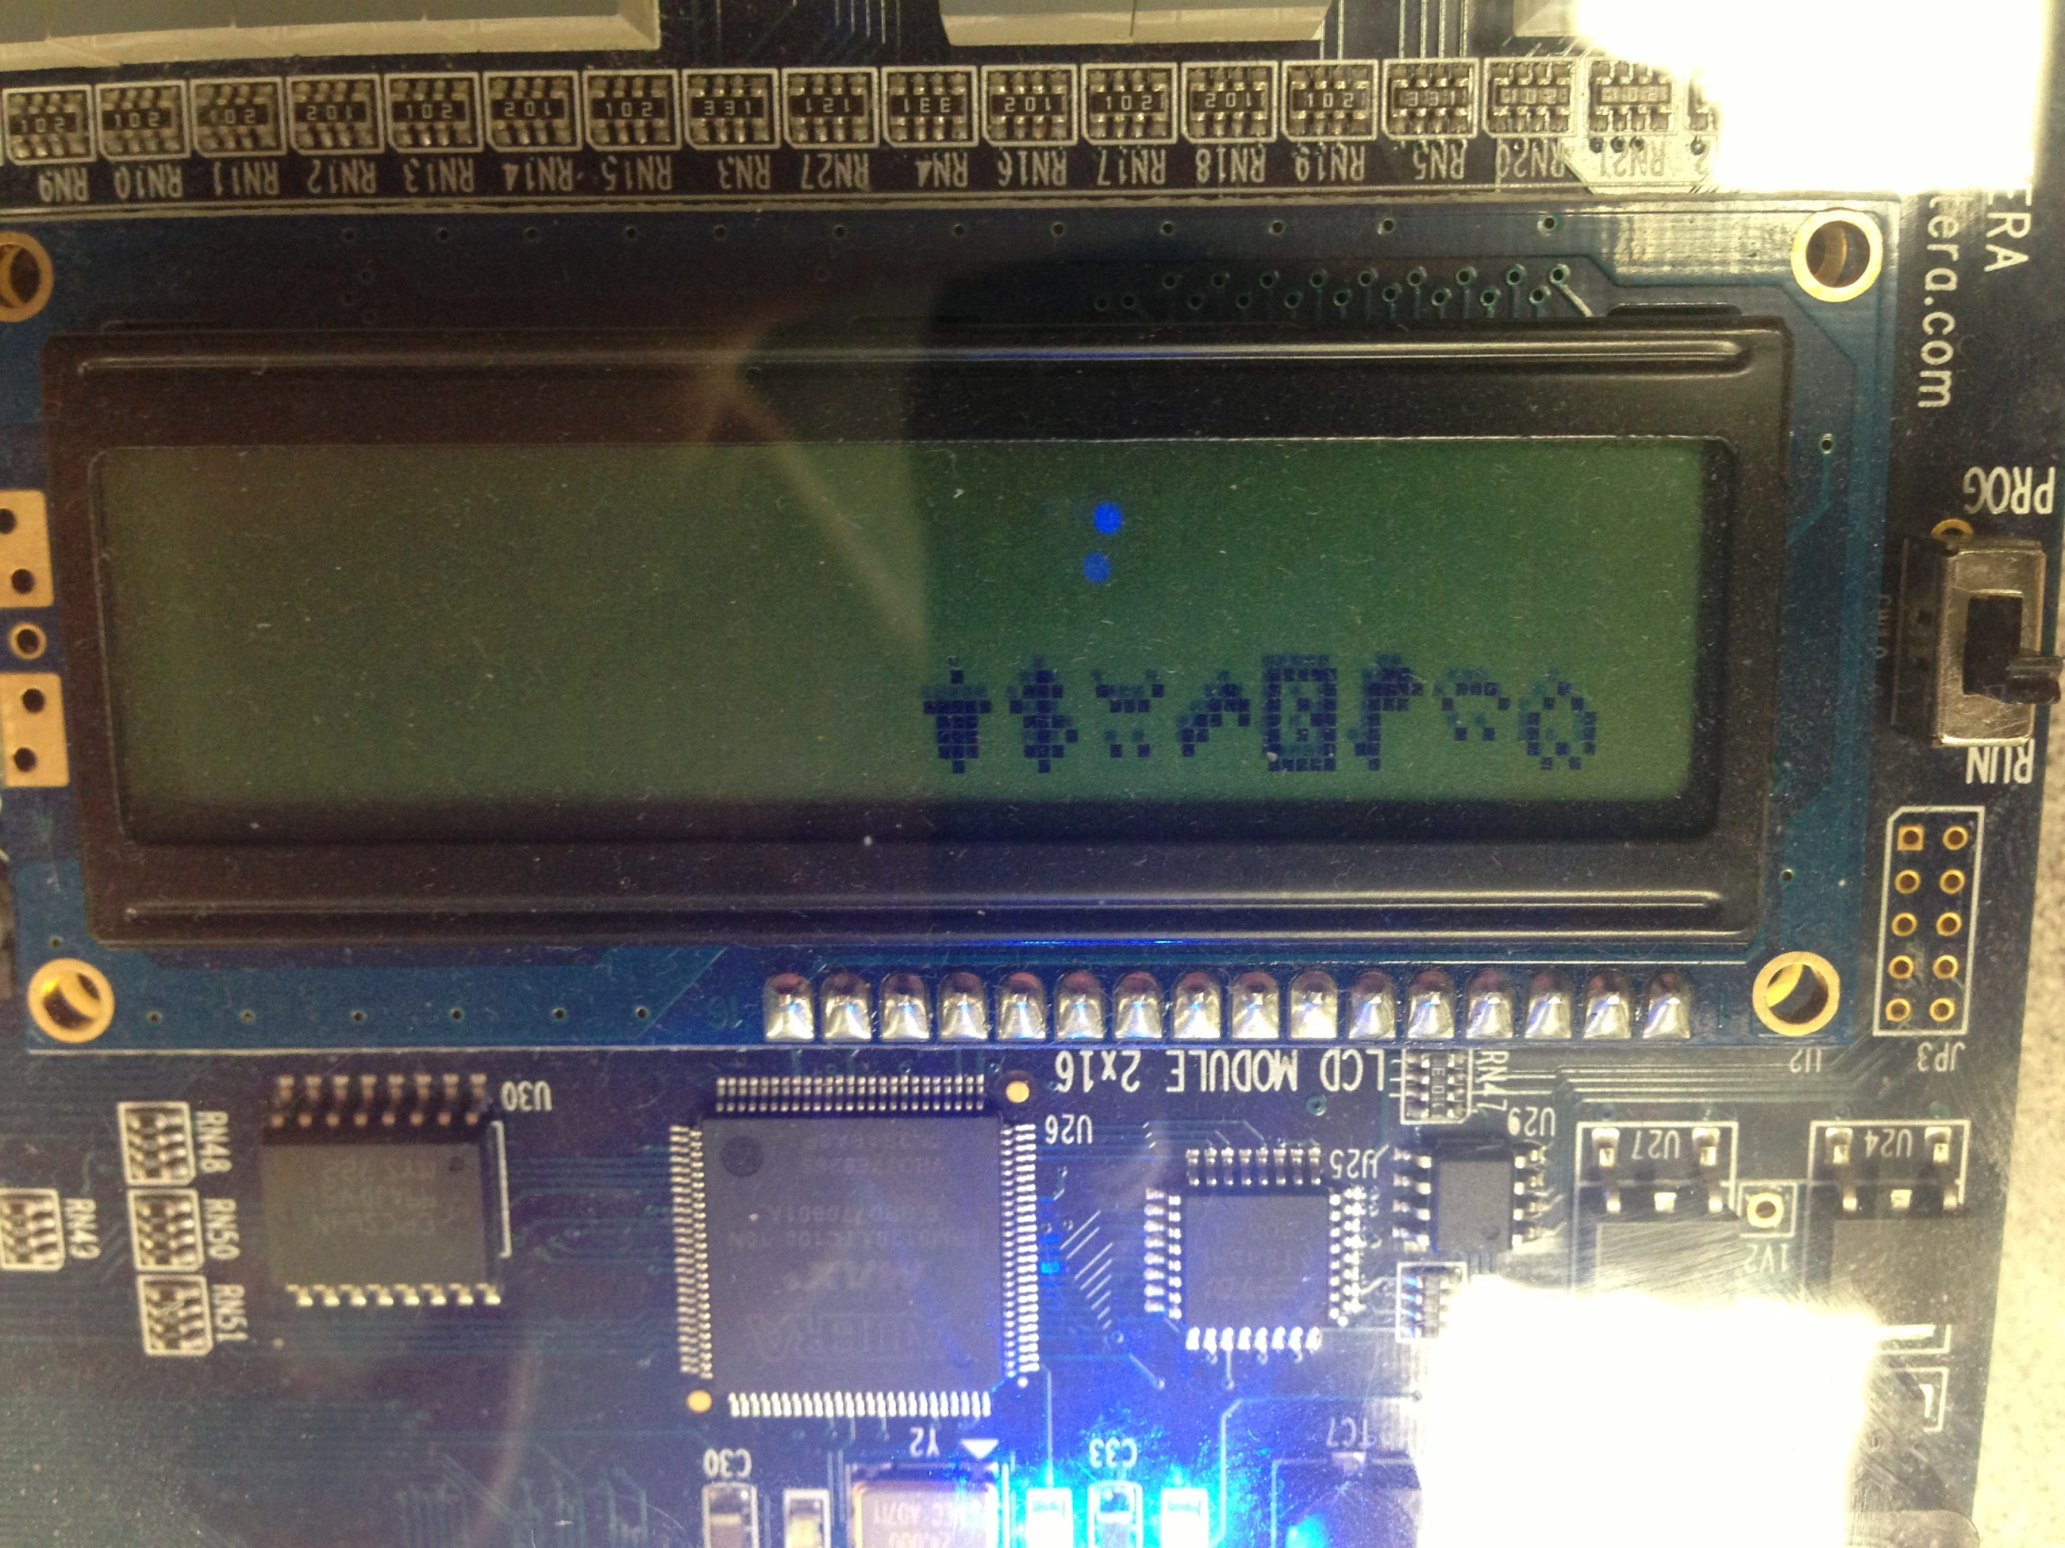

Slide 17
References
. "CFAH1602B-TMC-JP." http://www.crystalfontz.com. Crystalfontz America. Web. 3 Dec 2012.
Chaudhary, Gaurav. "Microcontroller Projects." : Custom Character Generations on 16x2 Char Lcd. N.p., 08 Feb. 2012. Web. 03 Dec. 2012. <http://www.circuitvalley.com/2012/02/lcd-custom-character-hd44780-16x2.html>.

Slide 18
